Slide 1

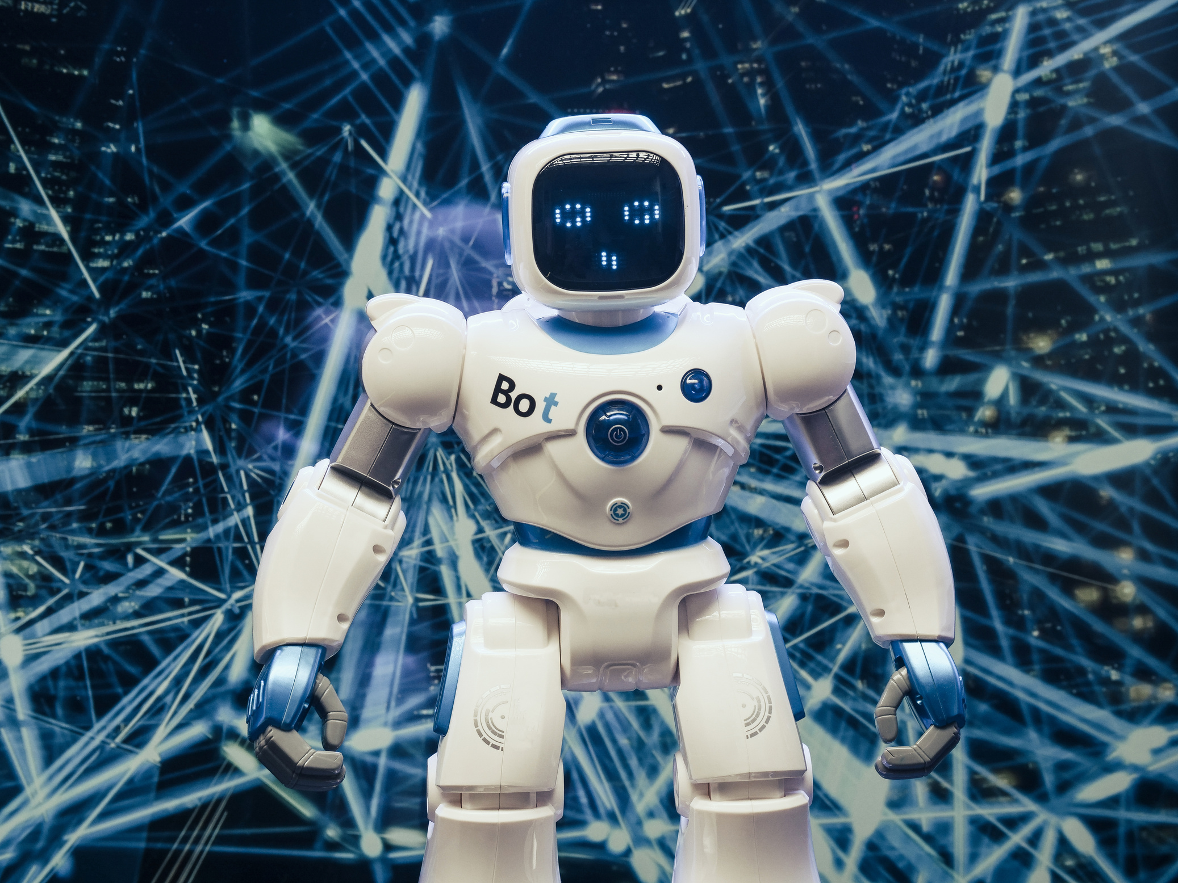




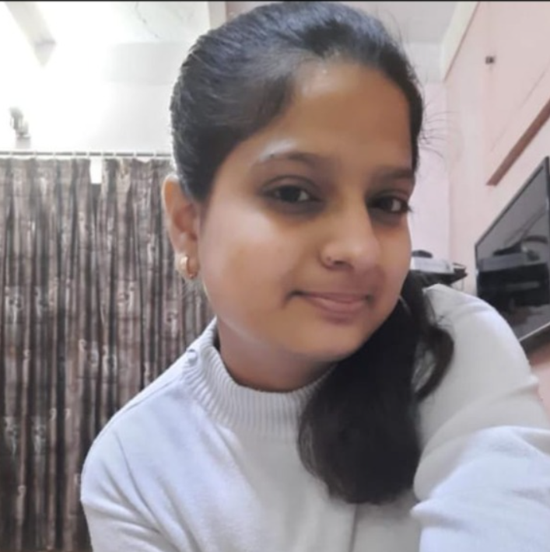
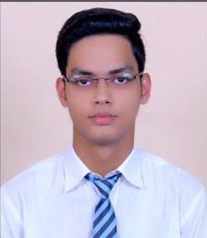
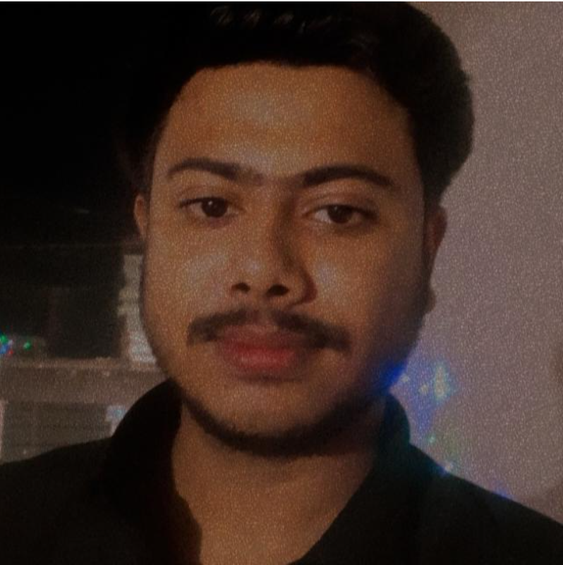
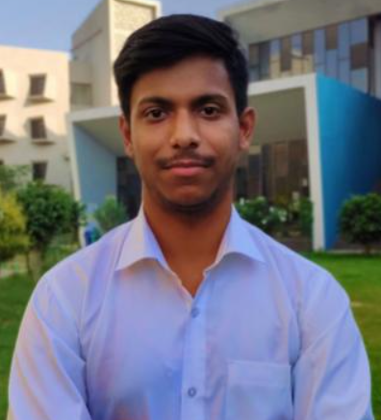
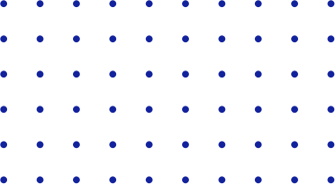
Cartoonify image with ML
Supervision by: Ankur Chaturvedi
Add
Photo
Add
Photo
Add
Photo
Add
Photo
Etisha Jain
Harshit Garg
Arnav
Srivastava
Vishu Goyal

Slide 2



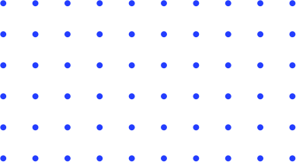

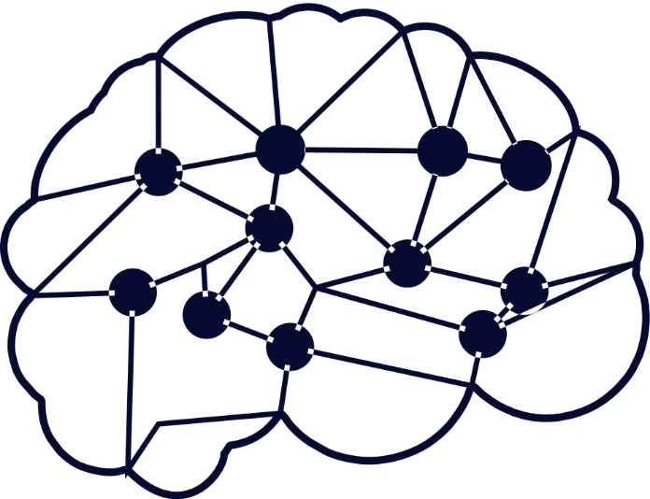
Index of Presentation
01
Introduction
04
Save the Image
02
05
Results & Experiments
Step of the project
03
Input the image
06
Conclusion & Future Work
07
References

Slide 3


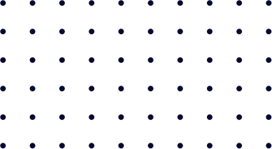


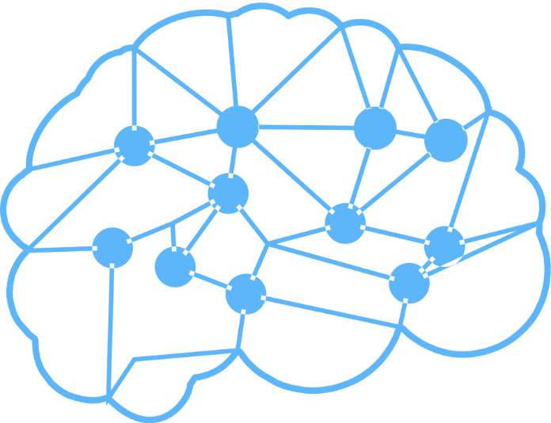
Introduction

Slide 4

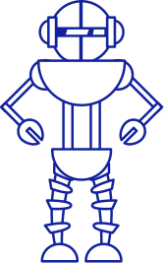

Uses or Applications of Topic in Real Life Scenario
SnapChat
Instagram
Animation
Selfie
This robot icon can be replaced based on your theme of the paper

Slide 5

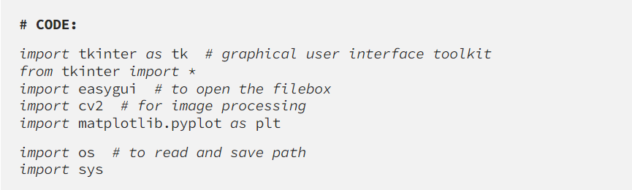

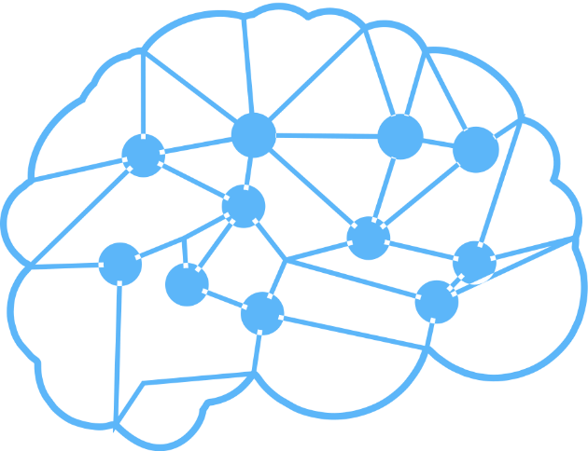
Steps to create the Cartoonifier app
Step 1: Importing the required modules

Slide 6
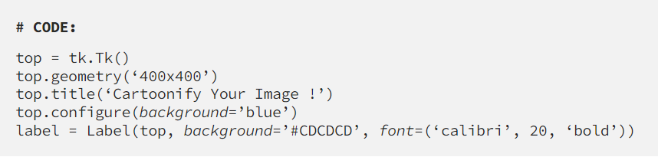
Step 2: Making the GUI main window

Slide 7
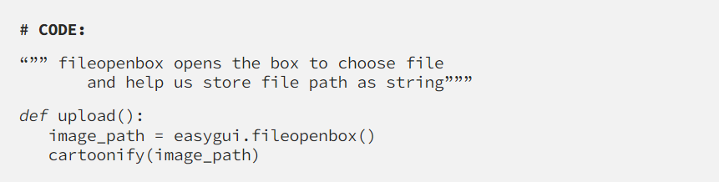
Step 3: Create a File Box to choose a particular file

Slide 8
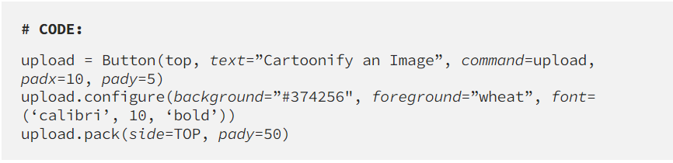
Step 4: Making the Cartoonify button in the GUI main window

Slide 9
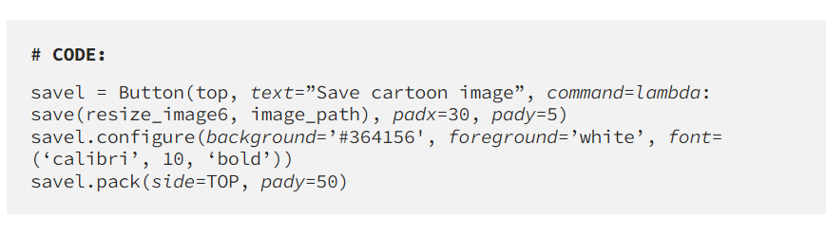
Step 5: Making a Save button in the GUI main window

Slide 10
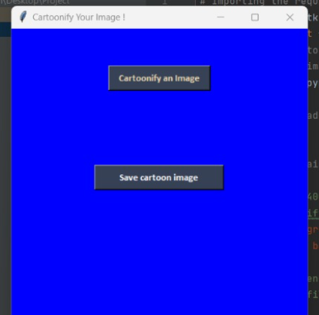
Step 6: Main function to build the GUI window

Slide 11
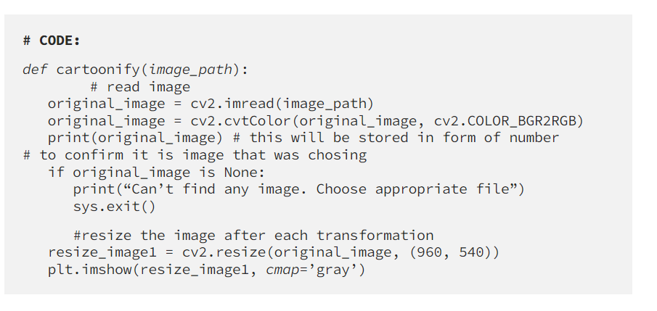
Step 7: How is an Image stored?

Slide 12
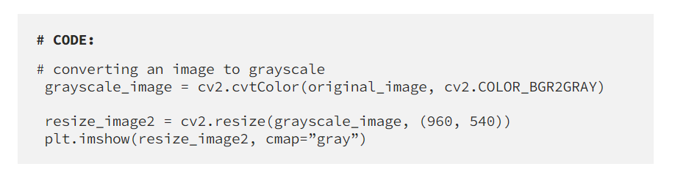
Step 8: Image transformation to grayscale

Slide 13
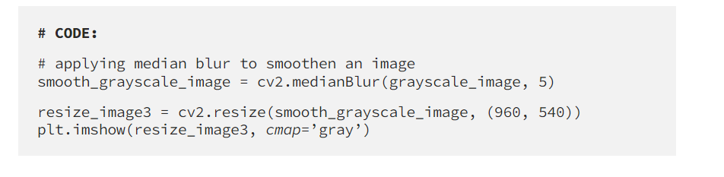
Step 9: Smoothening a grayscale image

Slide 14
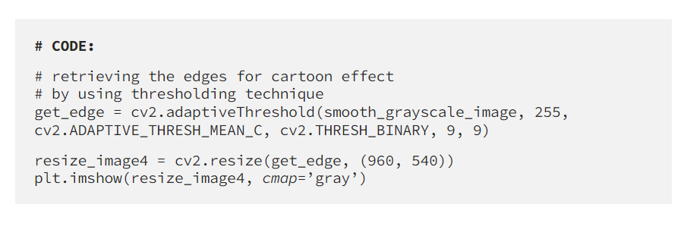
Step 10: Extracting the edges in the image (Highlighted Edges)

Slide 15
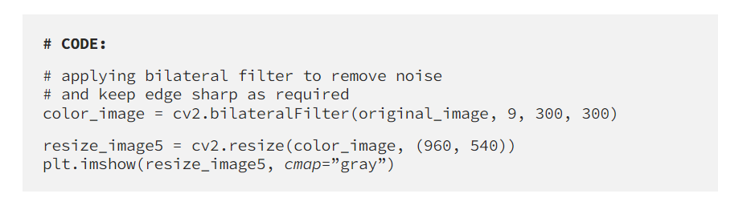
Step 10b: Cartoon effect specialities:- Smooth colours

Slide 16
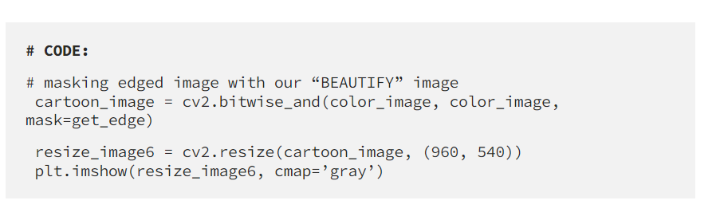
Step 11: Giving a Cartoon Effect

Slide 17
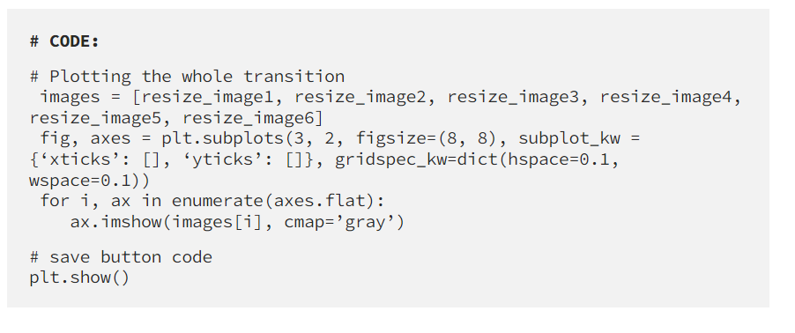
Step 12: Plotting all the transitions together

Slide 18
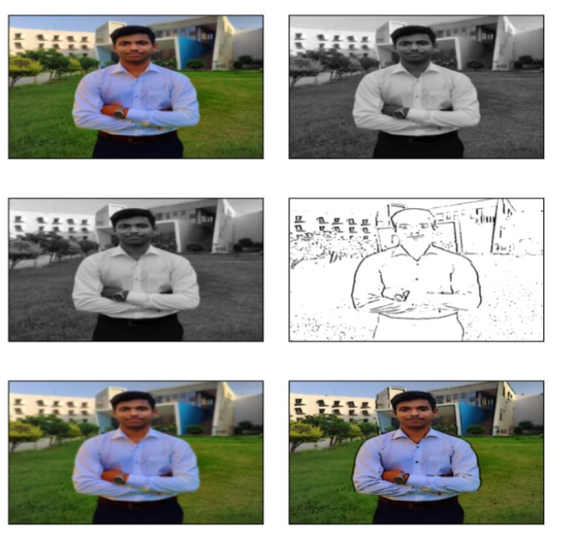
Step 12: Plotting all the transitions together

Slide 19
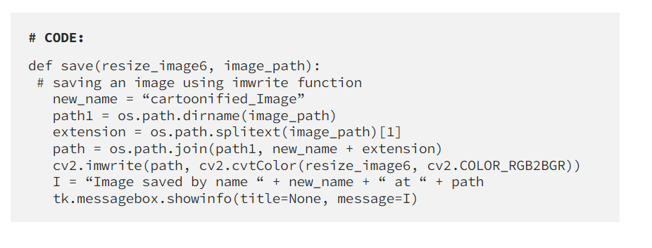
Step 13: Enhancing the save button

Slide 20
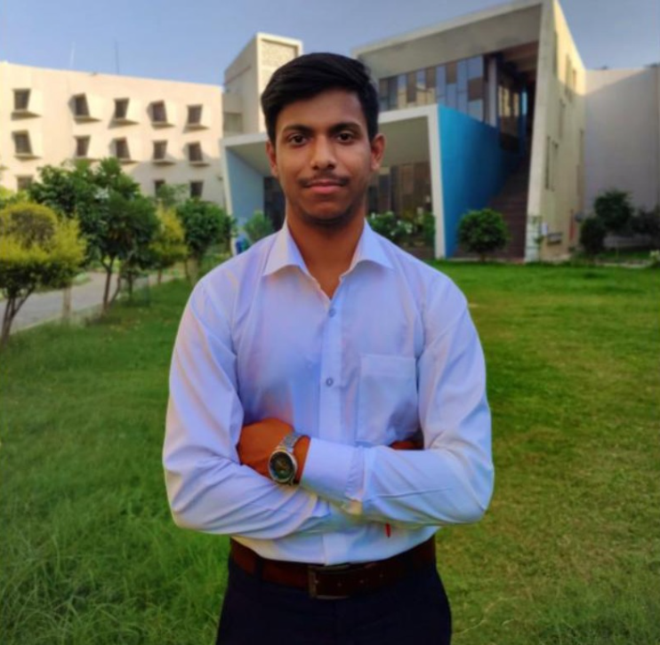
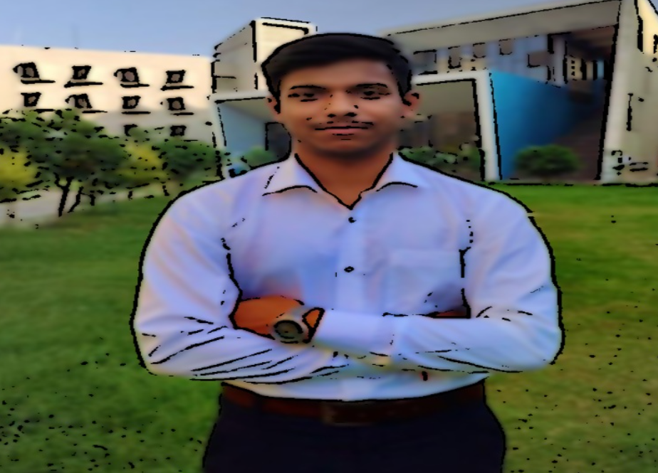
Experiments and Results

Slide 21
Conclusion and Future Work
Summary
We have successfully developed Image Cartoonifier with OpenCV in Python. This is the magic of OpenCV which let us do wonder and it is just a piece of what openCV can offer.
0
02
04
Future Work

Slide 22
References
[1] Youtube
[2] medium.com
[3] StackOverFlow
[4] Python.org
[5] openCV.org

Slide 23




Any Queries

Slide 24
Thank You

